Slide 1
Employee Data Analysis using Excel
STUDENT NAME: POORNIMA G
REGISTER NO: 312209778 ,asunm1353312209778
DEPARTMENT: B.COM(COMPUTER APPLICATIONS)
COLLEGE: ANNA ADARSH COLLEGE FOR WOMENS

Slide 2
PROJECT TITLE
Employee Performance Analysis using Excel

Slide 3


AGENDA
Problem Statement
Project Overview
End Users
Our Solution and Proposition
Dataset Description
Modelling Approach
Results and Discussion
Conclusion
3/21/2024 Annual Review

Slide 4

PROBLEM STATEMENT Analyzing employee performance in organizations ; Improvement and Development: It helps identify areas where employees can improve and provides them with feedback and resources for professional development. Goal Alignment: Performance reviews ensure that employees' goals are aligned with organizational objectives, helping to drive the company's success. Recognition and Motivation: It allows organizations to recognize and reward high performers, which can boost morale and motivation. . Resource Allocation: By assessing performance, organizations can make informed decisions about promotions, raises, and training needs. Problem Identification: Performance analysis can help identify and address potential issues or inefficiencies within teams or departments.

Slide 5

PROJECT OVERVIEW The employee performance project aims to enhance productivity and align individual goals with organizational objectives. The scope includes evaluating employees across various departments, focusing on specific competencies and achievement of targets. The methodology involves using performance appraisals, self-assessments, and peer reviews, with clear criteria based on qualitative and quantitative metrics. The project will follow a defined timeline with milestones for evaluation periods and deadlines for feedback.
.

Slide 6

WHO ARE THE END USERS? Employees: They receive feedback and development plans based on the evaluation results, which impact their personal and professional growth . Managers/Supervisors: They use performance data to make informed decisions regarding promotions, raises, and training needs, and to provide support and guidance to their team members. HR Personnel: They are involved in administering the evaluation process, ensuring consistency and fairness, and using the data for broader organizational planning and development initiatives . Executive Leadership: They may review aggregated performance data to assess overall organizational effectiveness, identify trends, and make strategic decisions about resource allocation and organizational goals.

Slide 7

OUR SOLUTION AND ITS VALUE PROPOSITIO Conditional Formatting-missing Filter-remove Formula-performance Pivot-summary Graph-data Visualizition

Slide 8
Dataset Description Employee- Kaggle 26-features 9-features Emp Id-num Name-text Emp Type Performance Level Gender-male Female Employee Rating-num

Slide 9

THE "WOW" IN OUR SOLUTION Performance level=IFS(Z8>=5,"VERY HIGH", Z8>=4,"HIGH",Z8>=3,"MED",TRUE,"LOW")
3/21/2024 Annual Review
9

Slide 10
MODELLING
Data collection
1)Data are collected from kaggle
2)Download the data
3)Convert from zip file to excel
Feature collection
01) Emp type
02) First and last of emp
Data cleaning
1)filter-remove
2)Conditional formatting=missing
performance level
1)pivot-summary
2)formula-performance
3)graph-data visualization
10

Slide 11
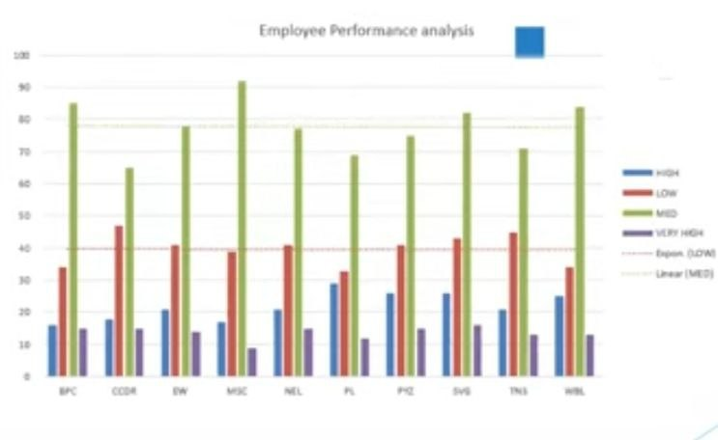
RESULTS
11

Slide 12
Conclusion Overview of Performance Trends: Summarize the overall performance trend observed. For instance, "Over the past quarter, employee performance has shown a steady improvement. Strengths and Achievements: Highlight areas where performance has been particularly strong. Areas for Improvement: Identify any areas where performance could be improved. For example, "While performance in project delivery is strong, there is room for growth in communication and teamwork."

